Slide 1

Heart Disease Prediction
Data Mining
Presented by Yara Al Ghaddaf and Zeina Ali Ahmad

Slide 2
Content of our Presentation
01
02
03
04
Data Understanding + Preprocessing
Background +
Problem +
objectives
ML Models + Methodology
Evaluation +
Results + discussion

Slide 3
Problem statement
Heart Disease
ML models
Classification
Identify whether a person has heart disease based on medical features.
Analyze clinical data to classify patients as “disease” or “no disease.”
Supervised learning and classification models
Early prediction = better prognosis
Helps doctors make faster and accurate diagnostic decisions.

Slide 4


Background : Data Mining
Process of extracting useful patterns from large datasets
Involves exploration, preprocessing, modeling, and evaluation
Crucial in decision-making

Slide 5



Background : Machine Learning
Classification
Regression
Clustering
Predict Categories
Predict continuous Values
Group similar unlabeled data

Slide 6
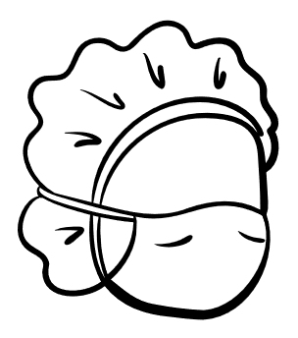

Why Apply ML to Medical Data?
Large complex and Multidimensional
Helps discover hidden patterns
Improves diagnostic accuracy, clinical decisions, reduces error.
Predictive models assist in risk assessment/early intervention.

Slide 7




ML Models used
Logistic Regression
KNN
Decision Tree
Linear model
Good baseline for binary
Classification
Distance-based
Classifies based on similarity to nearest neighbors
Key Hyperparameters: n_neighbors, metric, weights
Tree structure-Easy to interpret
Can overfit
Key Hyperparameter :
max_depth → maximum tree depth
criterion → gini or entropy
Random Forest
SVM
Ensemble of decision trees
More stable and accurate
Handles non-linear/complex relationships
Key Hyperparameters: n_estimators, max_depth, max_features
Finds optimal boundary between classes
Works well with high-dimensional data
Key Hyperparameter : kernel → linear, poly
C → regularization strength
gamma → curve shape

Slide 8
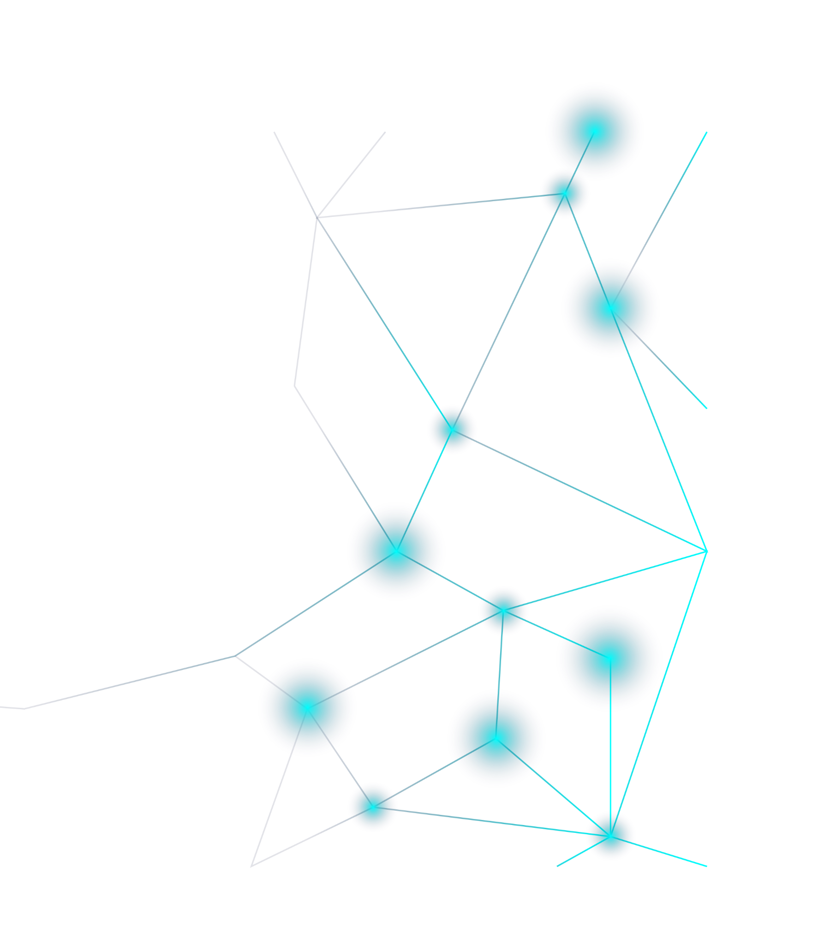

Can machine learning models accurately predict heart disease using patient clinical features?
Which ML model provides the best diagnostic performance?

Slide 9

Objectives
Preprocess and analyze a real-world dataset.
Train and compare multiple ML classification models.
Evaluate models using different metrics.
Apply cross-validation and hyperparameter tuning.
Present findings and insights using visualizations.
Apply knowledge learned in the Data Mining course to a real dataset.

Slide 10








Tools and Libraries
 | Datasource
 | Language : Python
 | Libraries: pandas, NumPy, scikit-learn, matplotlib, seaborn
 | Platform : Google Colab

Slide 11
Knowing and Understanding our Data
What features do we have?
Are the values skewed or normal
Are there missing values?
Which features relate to the target
ML models are only as good as the data they receive.

Slide 12
Features exploration
Chest pain
Type(1➔4)
Fasting blood sugar : if fasting
blood sugar > 120 mg/dL (0/1)
Electrocardiogram results at rest(0➔2)
Slope of the peak exercise ST segment(1 ➔3)
Chest pain caused by exercise (0/1)
Result of thallium stress test(3,6,7)
Disease or no disease (0/1)
Maximum heart rate achieved
Number of major blood vessels visible (0–3)
Cholesterol level in mg/dL
ST depression induced by exercise relative to rest.
Resting blood pressure (in mm Hg) measured when the patient is lying down.

Slide 13


Data Preprocessing
Missing Values
Binarization
Conversion
Standarization-Scaling

Slide 14
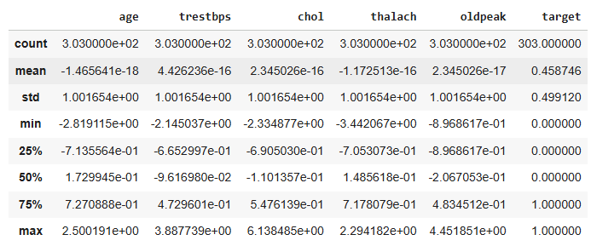
Summary statictics

Slide 15
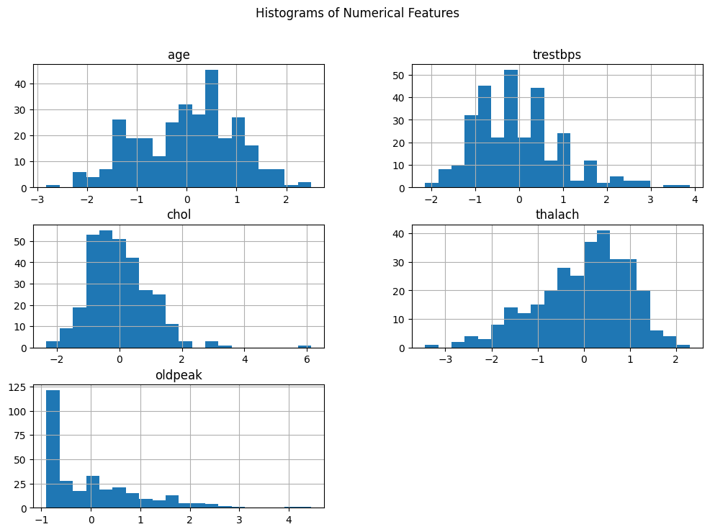
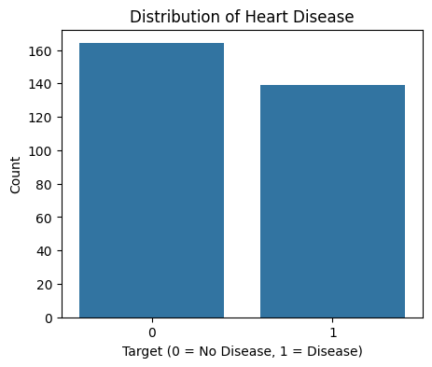
Understanding our Data using statistical graphs (EDA)
-Age : heart disease risk increases with age (affect middle aged~normal distribution)
-Chol shows right-skew : some patients have high cholesterol.
-Oldpeak is very skewed : high values may indicate reduced blood flow to the heart.
-Thalach : Lower maximum heart rate during exercise is often seen in heart disease patients.
-Trestbps :Many patients have elevated blood pressure, a known risk factor for heart disease
~Balanced Dataset = Good sign

Slide 16
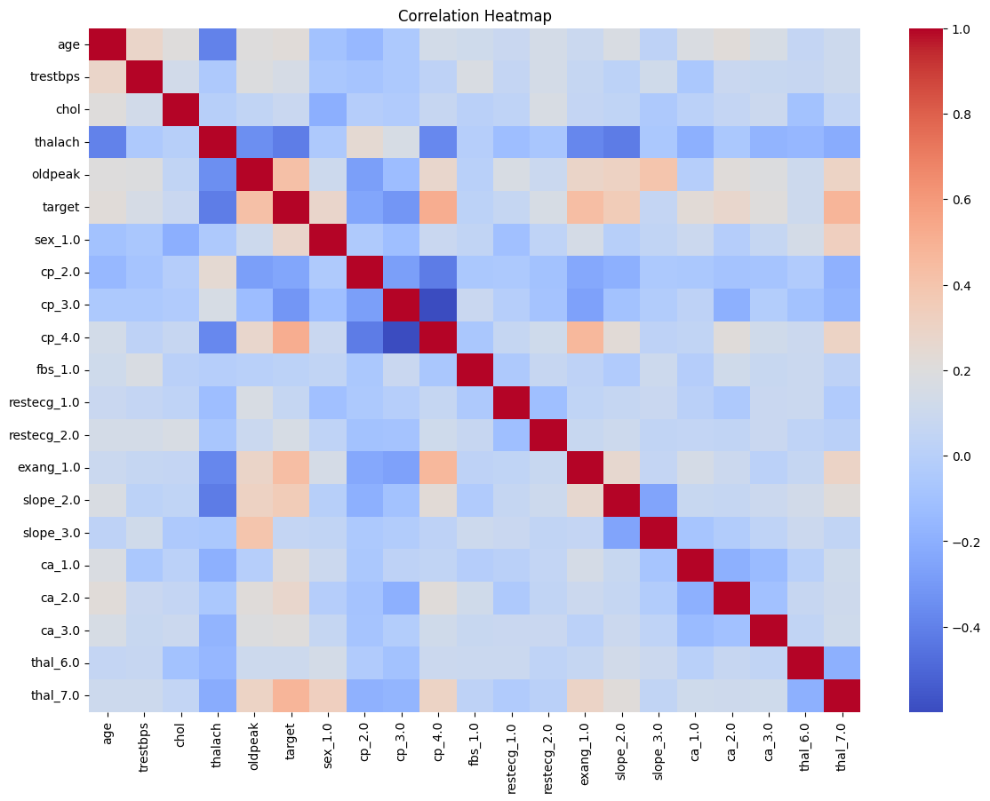
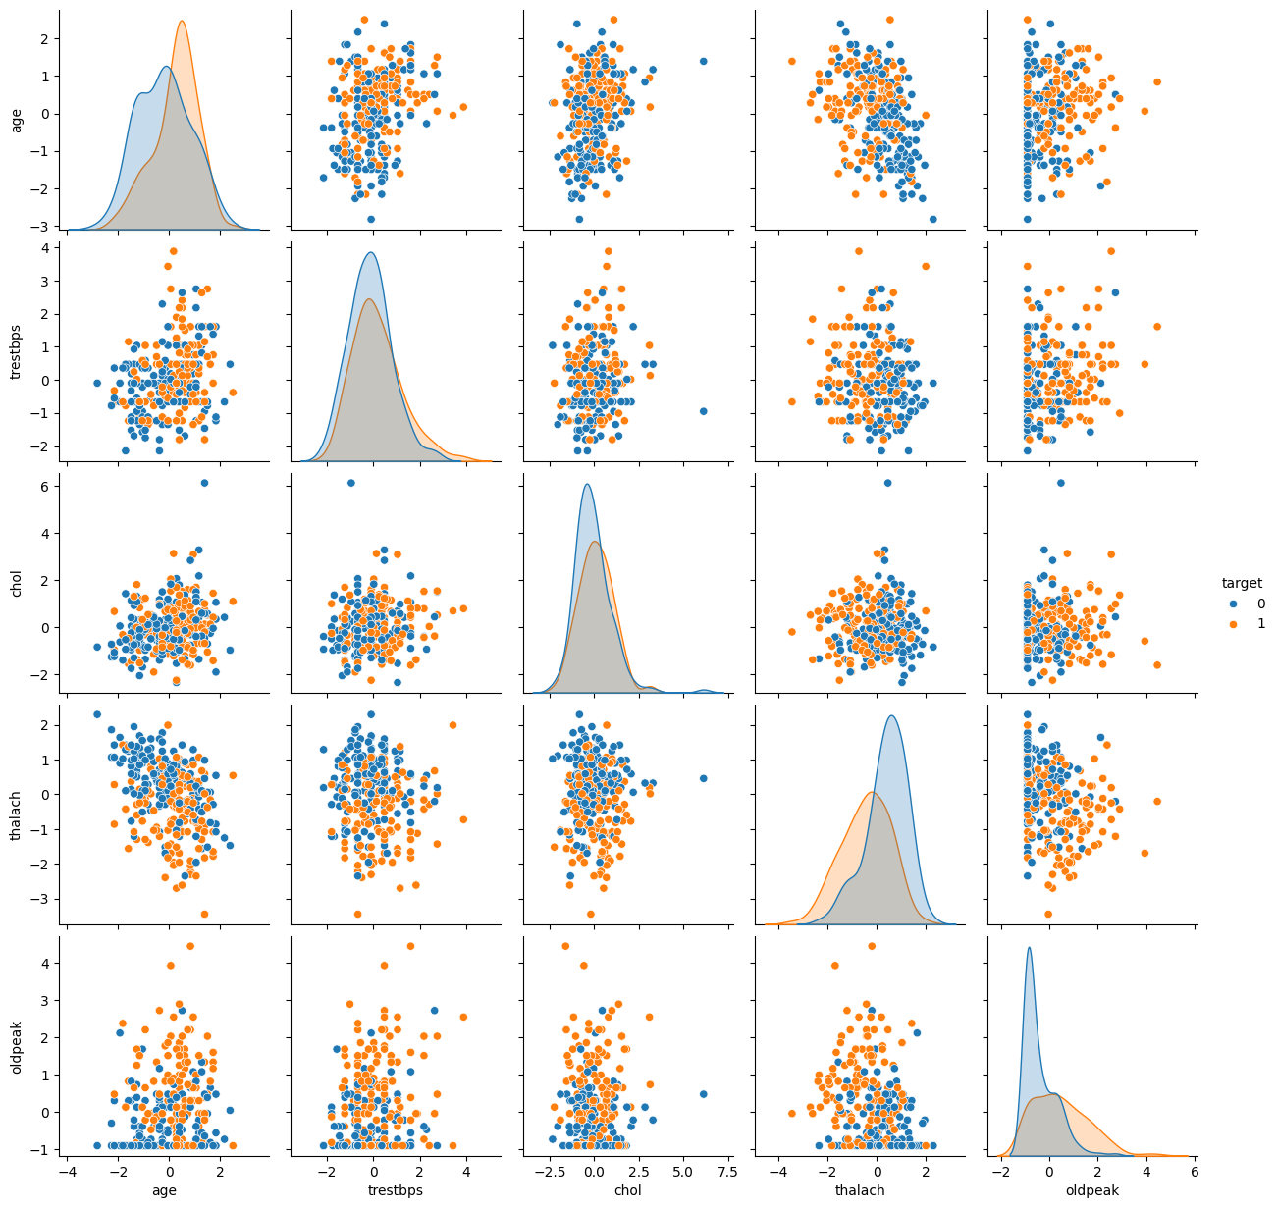
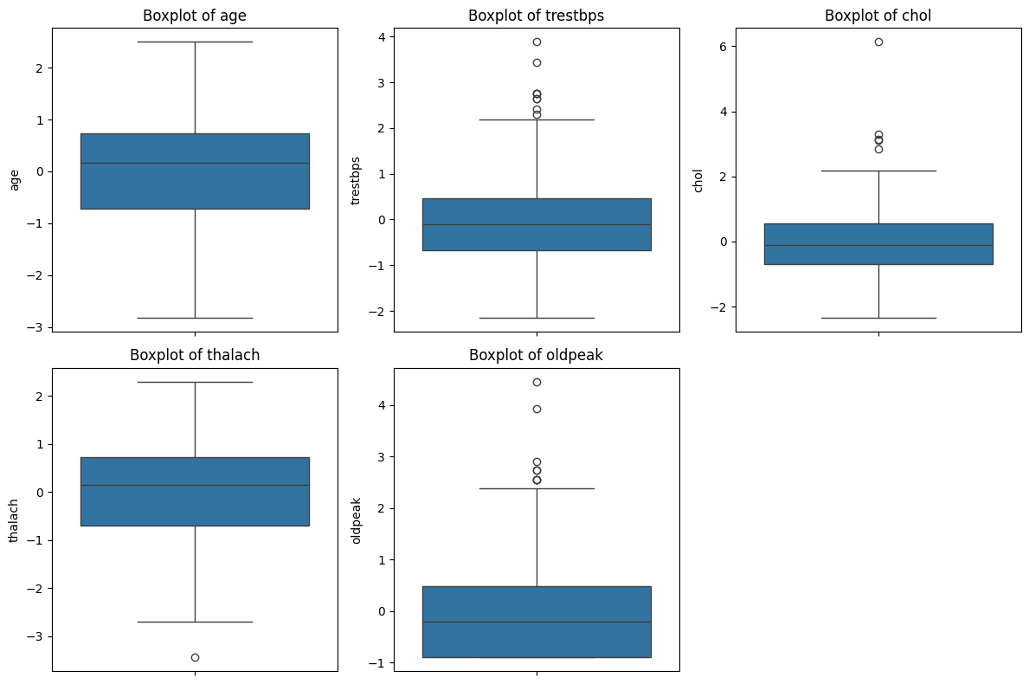
1- Chol, oldpeak, and trestbps have outliers. Oldpeak has extreme values (severe cases) ➔ Reflect real medical diversity in patients and help models learn disease patterns 2- Target is strongly correlated with lower thalach, higher oldpeak, chest pain type, exercise-induced angina : clinical signs of poor cardiac function 3- Patients with disease (orange) : lower thalach, higher oldpeak, different chest pain patterns.
3
2
1

Slide 17
Training and Testing Spliting
80%
20%

Slide 18
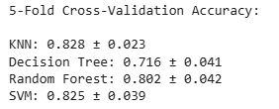
Cross Validation
Repeats training/testing on different splits
Ensures model generalizes well
Avoids lucky/unlucky train-test split results
Compare model performance fairly and avoid overfitting.
KNN and SVM performed best (accuracy around 82–83%
+ low variability → generalize well)
Random Forest performed strongly, with slightly higher variance.
Decision Tree performed worst = overfitting and instability

Slide 19



Hyperparameter Tuning
What does it do | Automatically finds the best parameters for each model
 | Uses GridSearchCV
Importance | Improves accuracy
 | Reduces overfitting
Models tuned | KNN, Decision Tree, Random Forest, SVM

Slide 20





Process
Train
Predict
Evaluate

Slide 21
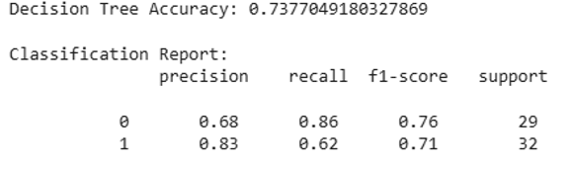
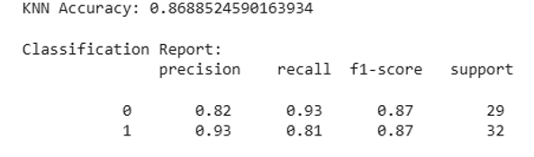
Output
Precision | Recall | F1 score | Support
Of all the patients the model predicted as sick, how many were sick? | Of all the patients who ARE sick, how many did the model detect? | A single score that combines precision and recall | How many actual patients belong to each class.
Mars is actually a very cold place | Venus has high temperatures | Mercury is the smallest planet | Jupiter is the biggest planet
Fast but lower accuracy: Decision Tree Balanced: Logistic Regression, SVM Highest accuracy but more computational cost: KNN,,RF Conclusion: More complex models tend to perform better but require more computational resources.

Slide 22
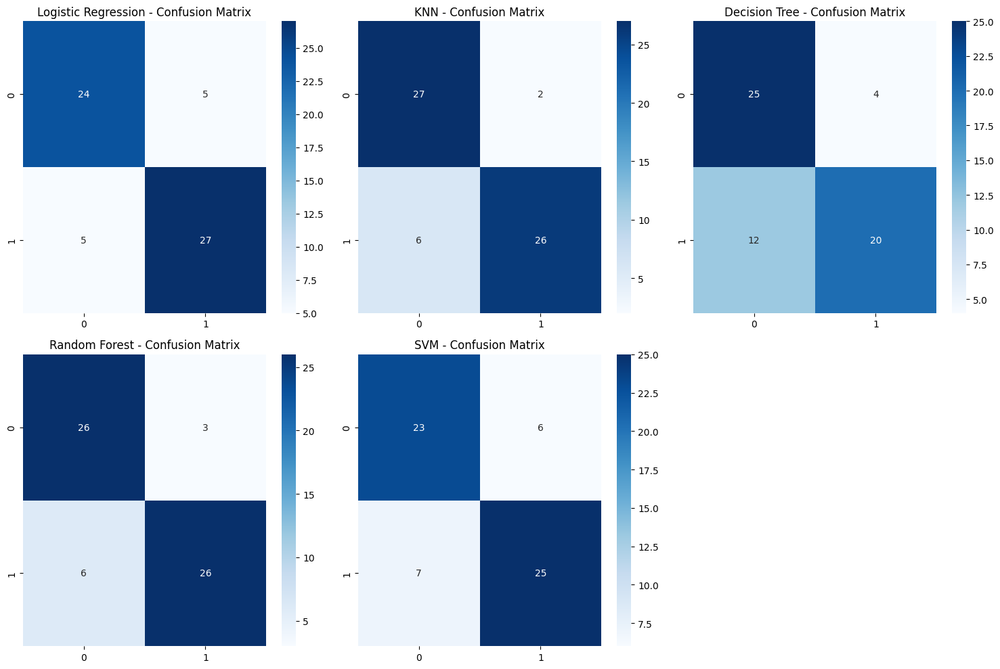
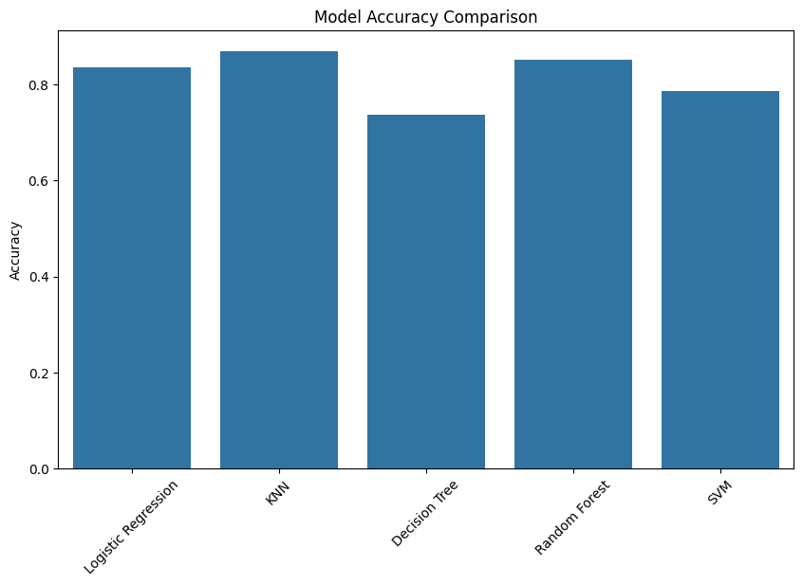
-KNN and Random Forest achieved the highest accuracy (~86–88%).
-SVM decent (~78–80%).
-Logistic Regression well (~84%).
-Decision Tree performed the worst (~73%).
-KNN and Random Forest make the fewest mistakes.
-Decision Tree has many false negatives (predicts healthy when patient is truly sick).
-SVM and Logistic Regression are balanced but less accurate than RF and KNN.

Slide 23
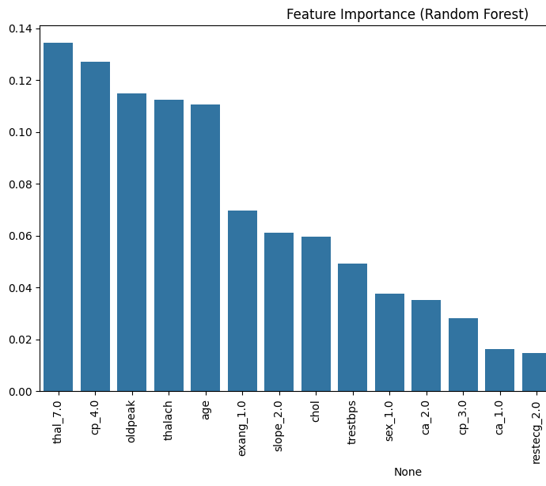
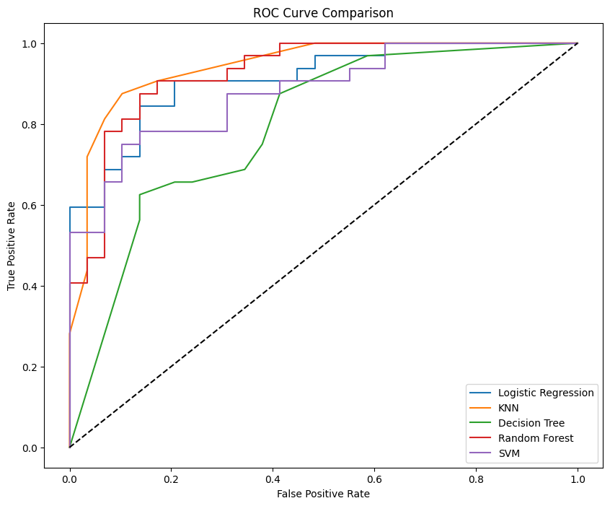
This tells us which medical factors influence the prediction most ➔interpret the model and connect results to medical meaning.
ROC curve : how good each model is at separating healthy vs sick patients, independent of threshold. Higher curve = better classifier.

Slide 24
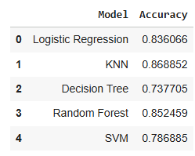
Discussion
Key results
What worked well?
Value of the project
Random Forest & SVM
Cross-validation and tuning improved model performance.
EDA helped identify key patterns early.
Limitations : dataset size/reliability
How ML help doctors detect heart disease early and accurately.
Reveal the most important medical features influencing prediction.
Demonstrates the practical value of data mining in real healthcare problems.
Conclusion
Non-linear relationships in data
Some features had skewed distributions
Ensuring no overfitting
Larger medical datasets
DL models
More clinical features (ECG, imaging, symptoms)
Real-time prediction systems Smartwatch and wearable heart monitoring Remote monitoring for high-risk patients Personalized treatment recommendations Faster triage in emergency rooms
Challenges
How to improve?
Future work

Slide 25
Thanks you
Do you have any questions?
Please keep this slide for attribution

